Slide 1
Section 13.5
The Binomial Theorem
Copyright © 2012 Pearson Education, Inc. Publishing as Prentice Hall.

Slide 2
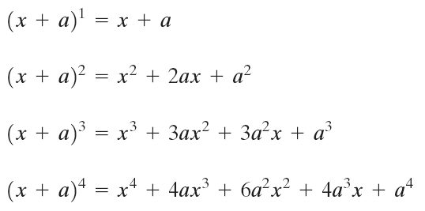
Copyright © 2012 Pearson Education, Inc. Publishing as Prentice Hall.

Slide 3
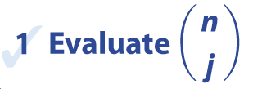
Copyright © 2012 Pearson Education, Inc. Publishing as Prentice Hall.

Slide 4

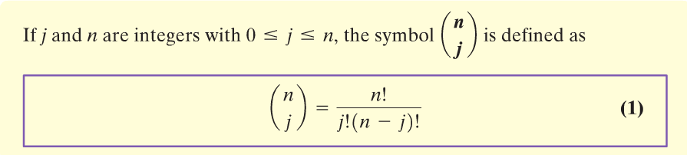
Copyright © 2012 Pearson Education, Inc. Publishing as Prentice Hall.

Slide 5


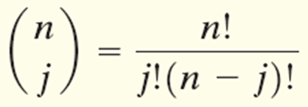
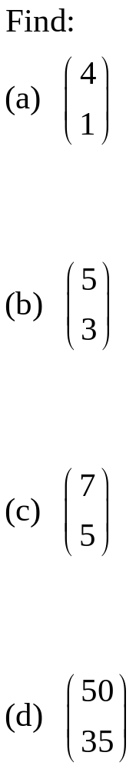
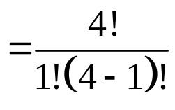
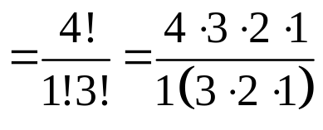

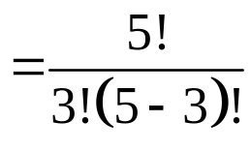
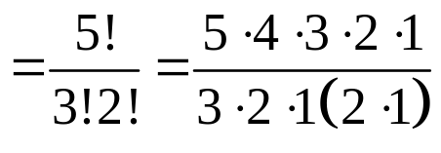

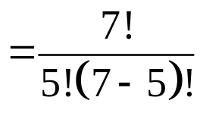

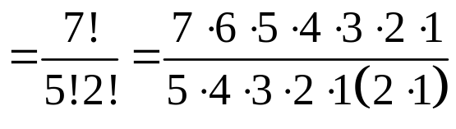

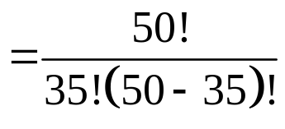
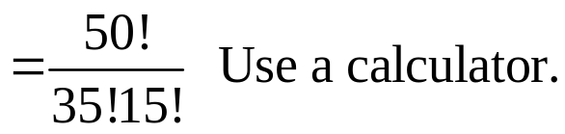
Copyright © 2012 Pearson Education, Inc. Publishing as Prentice Hall.

Slide 6

Four Useful Formulas
Copyright © 2012 Pearson Education, Inc. Publishing as Prentice Hall.

Slide 7
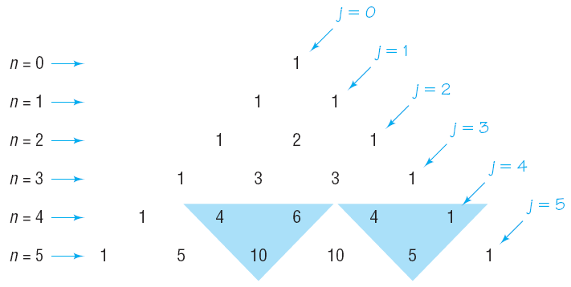
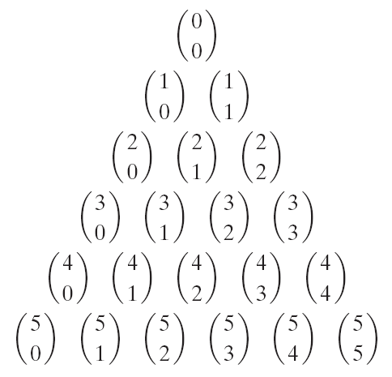

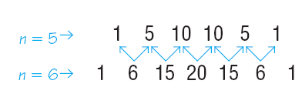
Copyright © 2012 Pearson Education, Inc. Publishing as Prentice Hall.

Slide 8

Copyright © 2012 Pearson Education, Inc. Publishing as Prentice Hall.

Slide 9
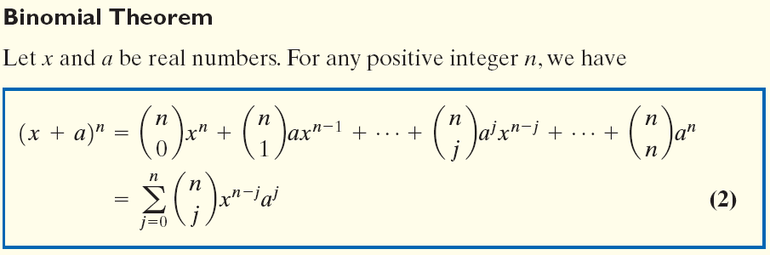
Copyright © 2012 Pearson Education, Inc. Publishing as Prentice Hall.

Slide 10

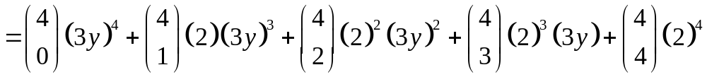

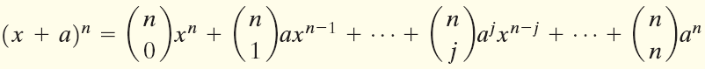
Copyright © 2012 Pearson Education, Inc. Publishing as Prentice Hall.

Slide 11
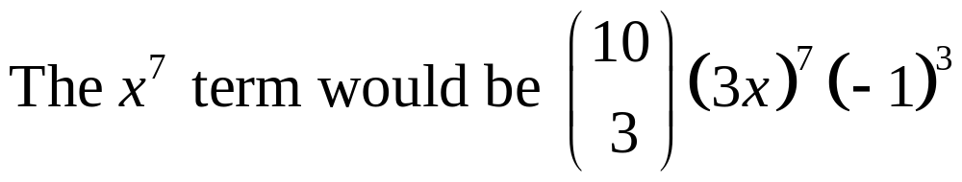
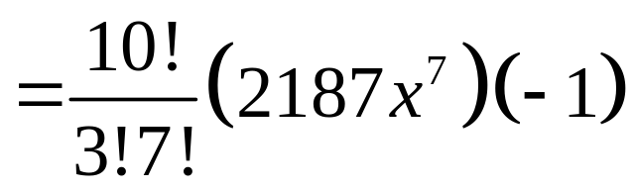
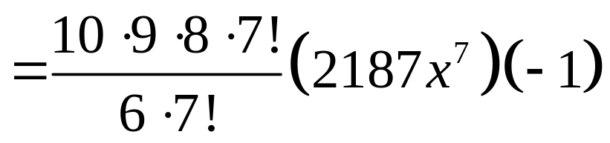
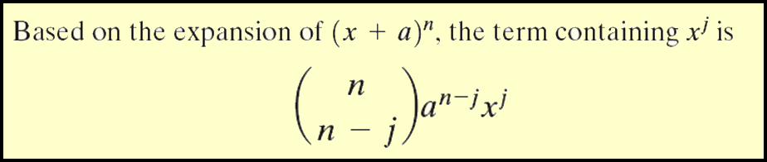
Copyright © 2012 Pearson Education, Inc. Publishing as Prentice Hall.

Slide 12
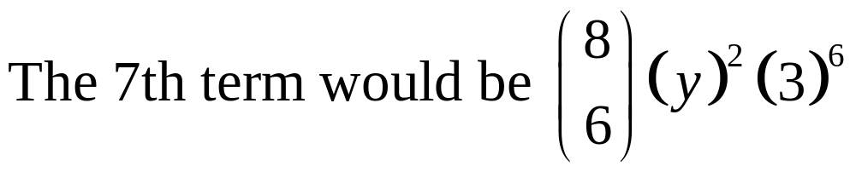
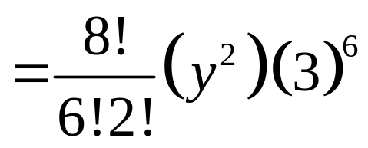
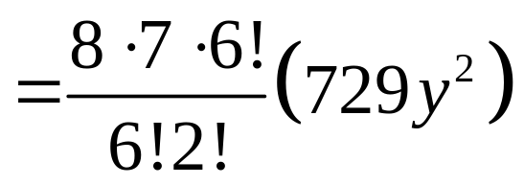
Copyright © 2012 Pearson Education, Inc. Publishing as Prentice Hall.

Slide 13

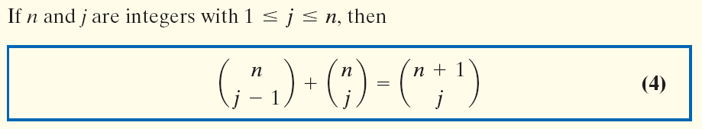
Copyright © 2012 Pearson Education, Inc. Publishing as Prentice Hall.

Slide 14
Copyright © 2012 Pearson Education, Inc. Publishing as Prentice Hall.

